Slide 1
“We Built a House” Watonga Effect
City of Watonga
By: Karrie Beth Little, City Manager

Slide 2
Time Line
9-2022- Local church donated a property – required to build a house.
1-2023- Attended OML Tribal symposium – met Bailey with Native American Chamber of Commerce/Susan Day with REI.
2-2023- Met with John Bunch, Zona Verde.
3-2023- City council signed to build a house.
4-2023- City council signed construction agreement.
House built and loaded on a ship
8-2023- House delivered in containers
9-2023- Ribbon cutting for house
Show home for 60 days. House listed on market.

Slide 3
Networking/Partnership
Oklahoma Municipal League
Oklahoma Municipal Management Services/CMAO
Native American Chamber of Commerce
Zona Verde, Inc.
Local businesses and citizens of Watonga
Lt. Governor’s office
Department of Commerce

Slide 4
Positive Outcome
Only house built in the City in 2023.
Will have net zero on the city finances.
First house built in the United States with Engineered Insulated Panels and 3 energy ratings.
Developed partnerships.
Economic impact to local community.
Opened opportunities for future initiatives in the local, regional and state, and national levels.

Slide 5
Feedback
Working with Watonga has taught me the inter workings of government and how to get things done. John Bunch, Zona Verde
I was inspired by the tremendous community spirit that I experienced and how everyone is committed to helping build their community for a better future. Randy Edgerton, Owner, Zona Verde
This house is great and how wonderful of the City of Watonga to make the investment in the community. Visitors of the house.

Slide 6
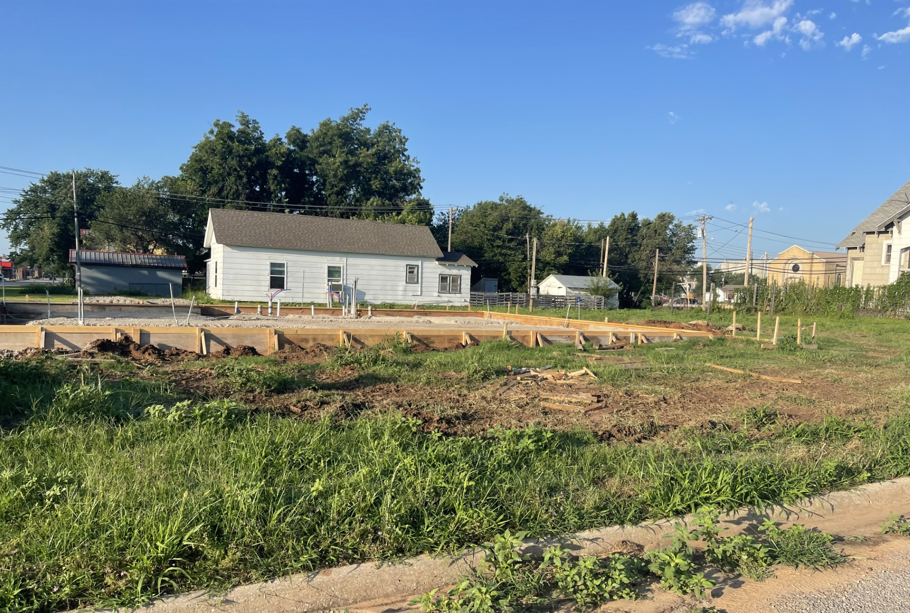
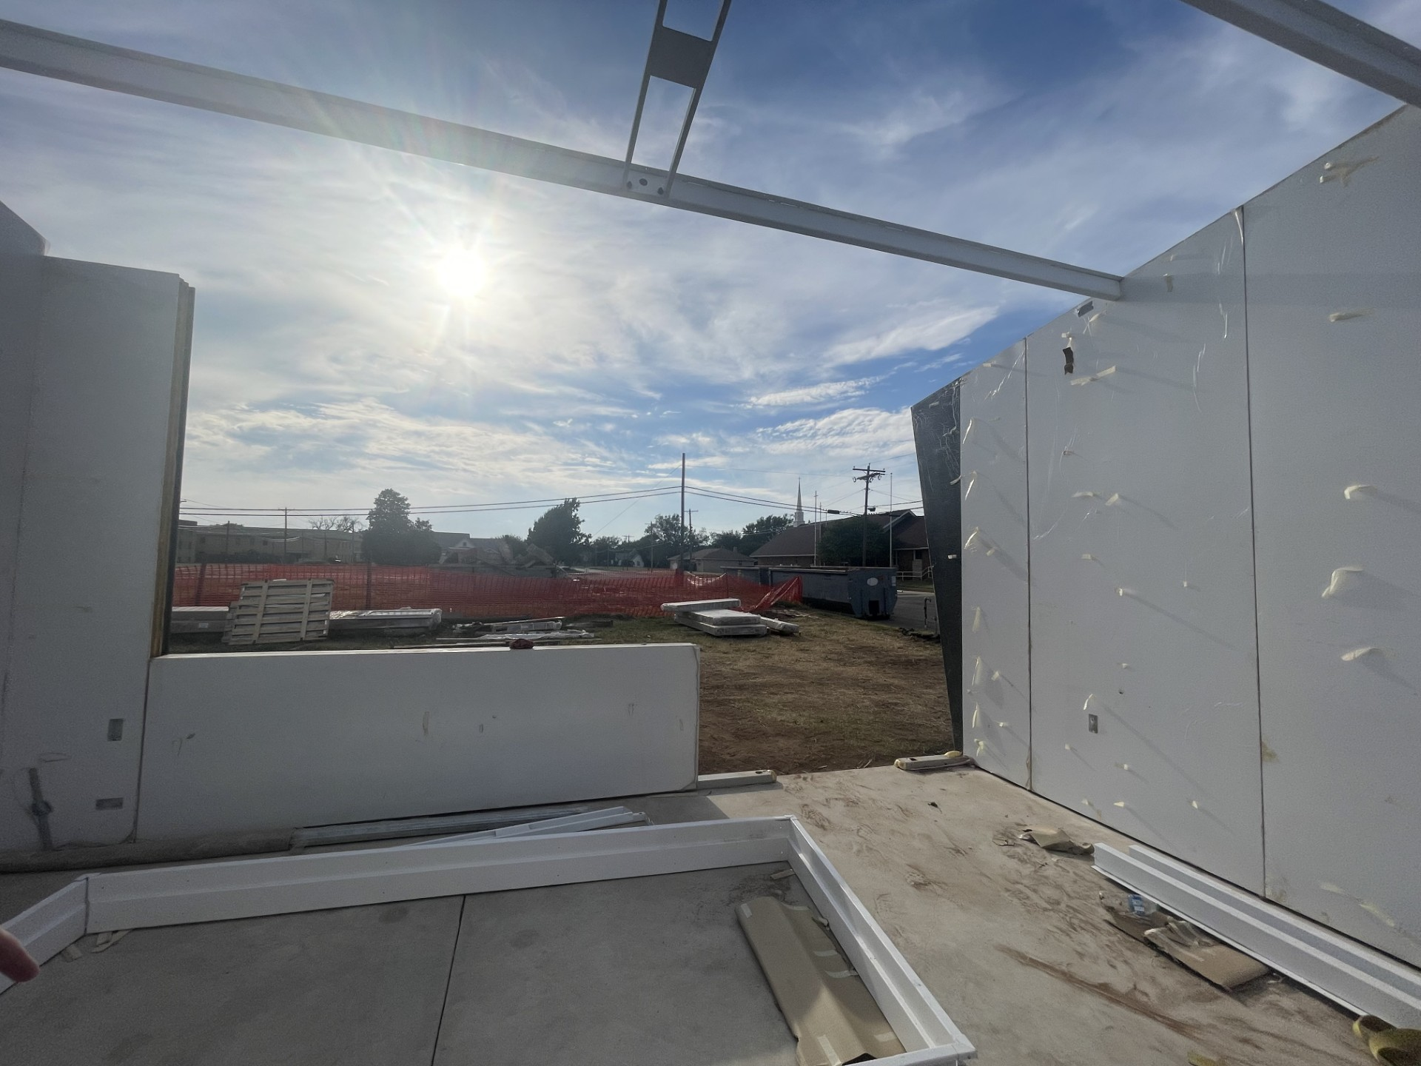
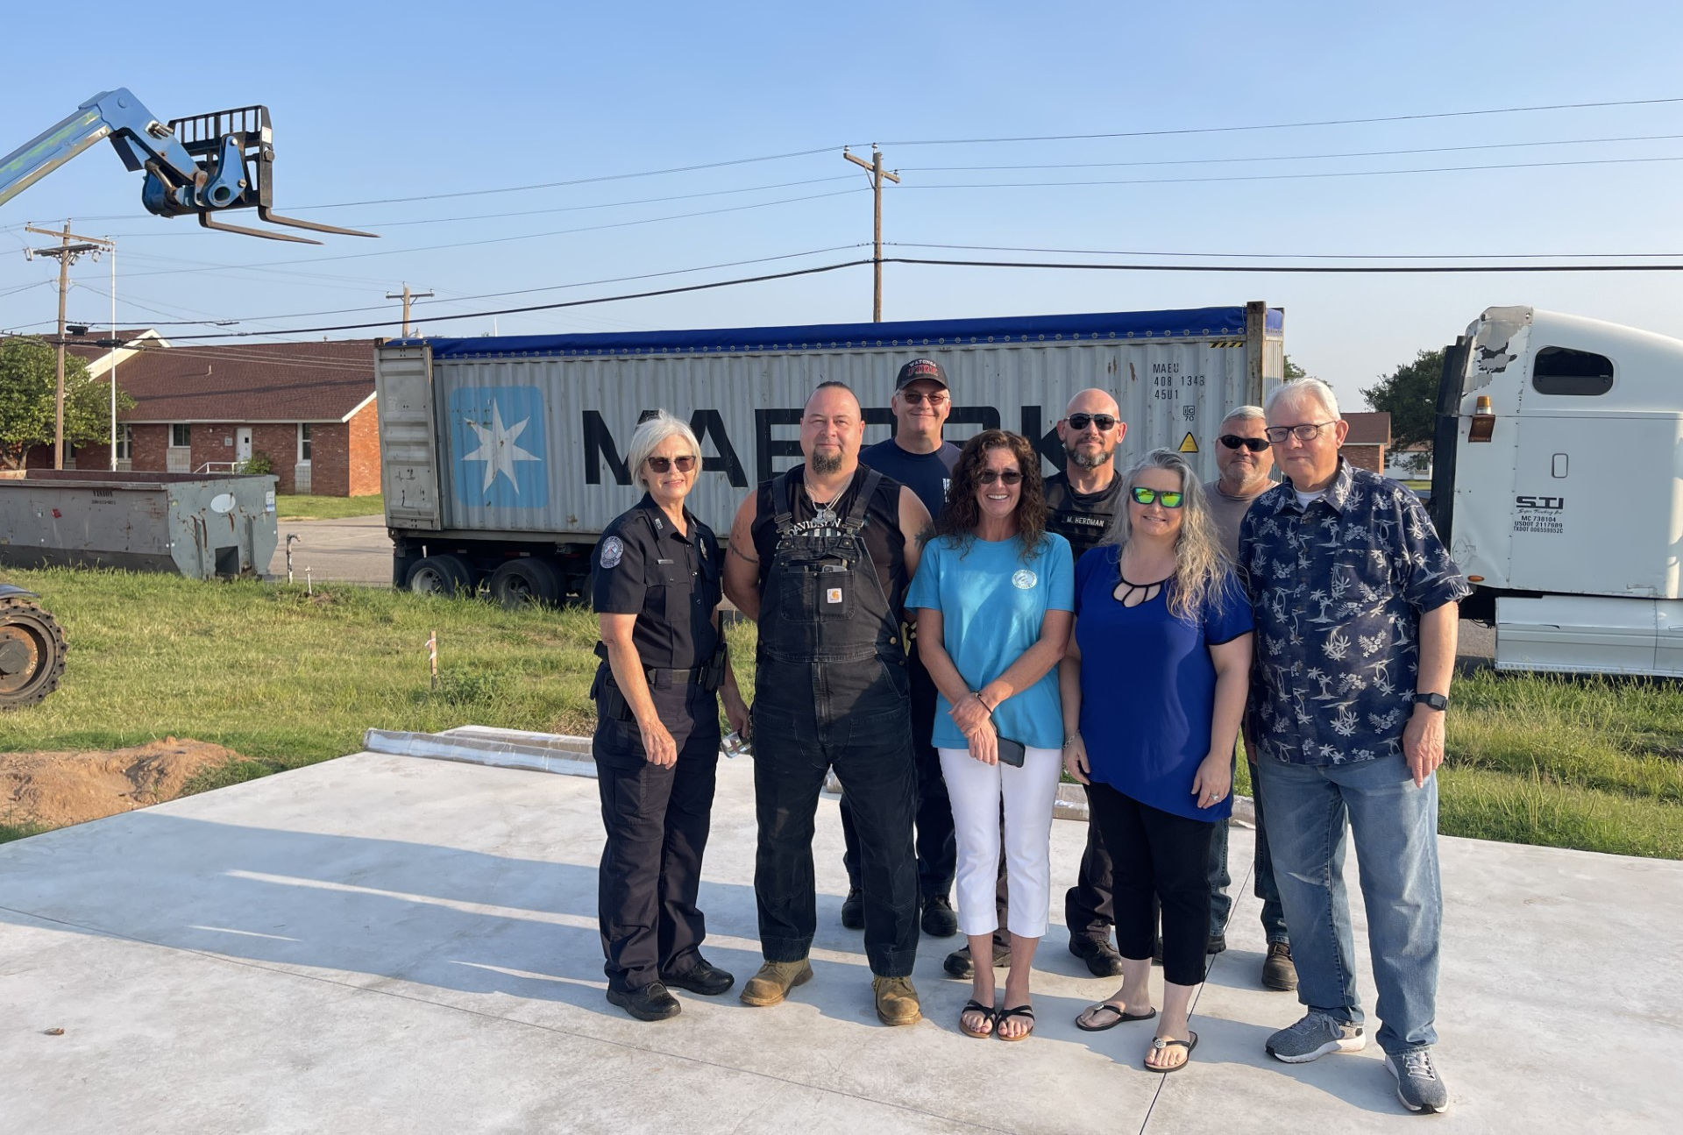

Slide 7
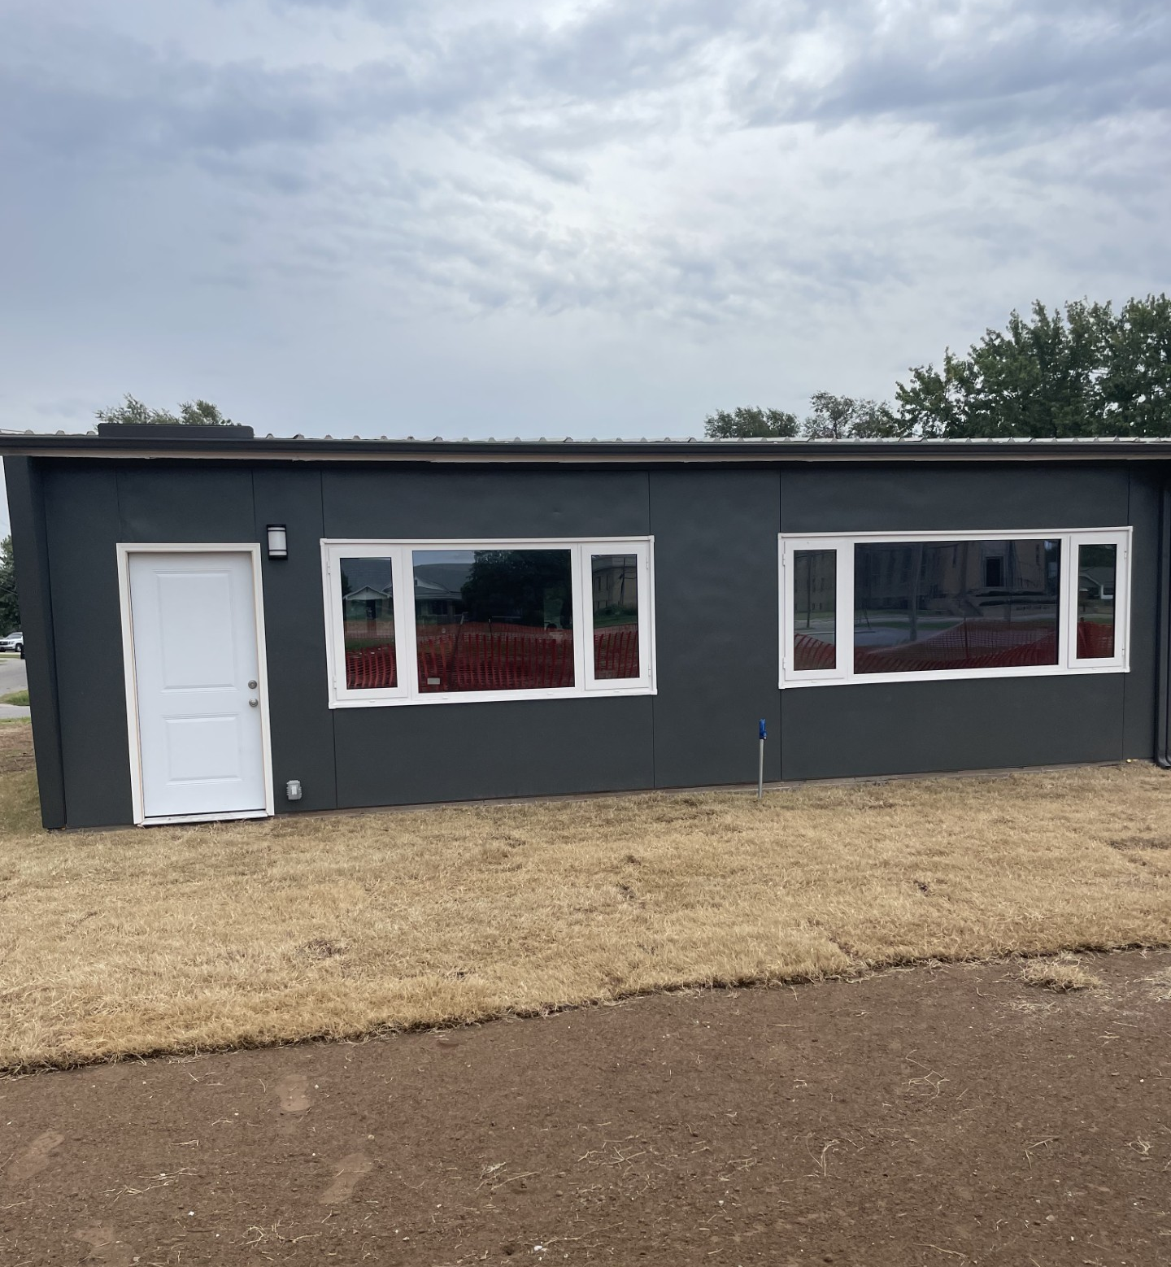
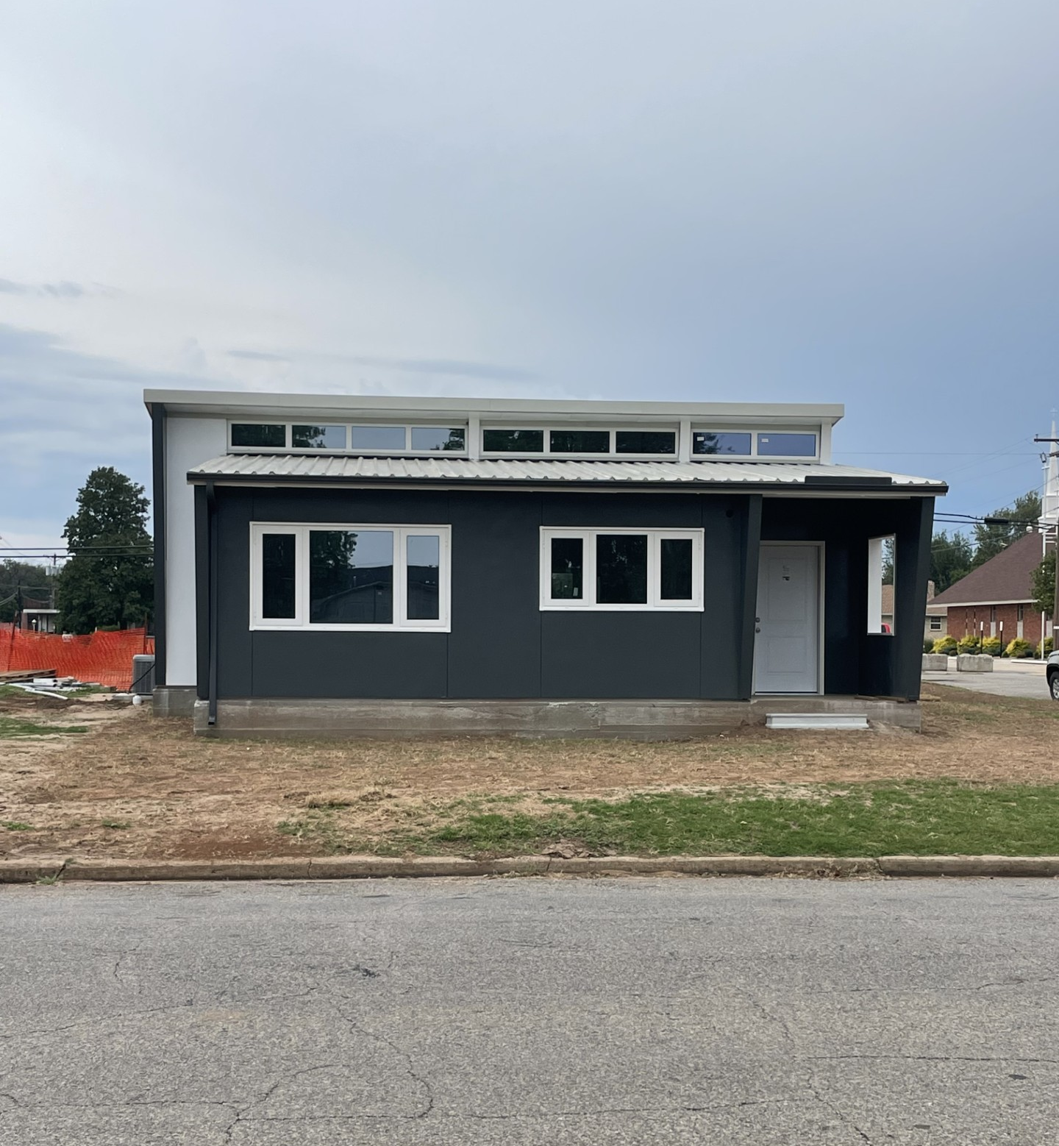

Slide 8
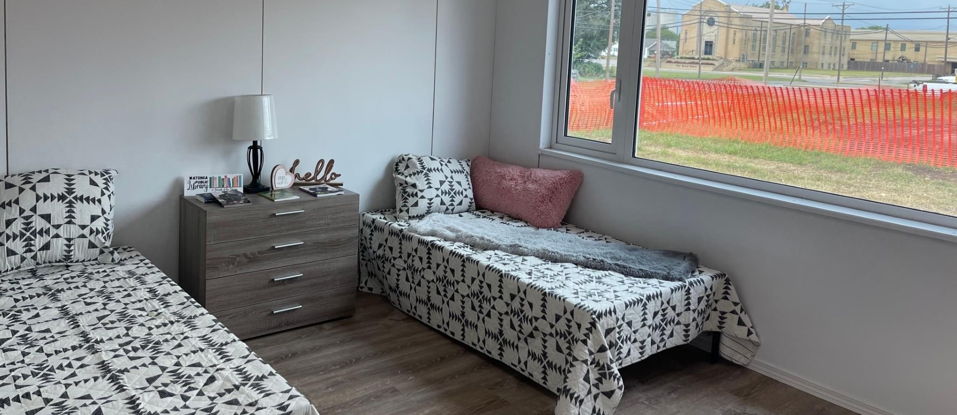
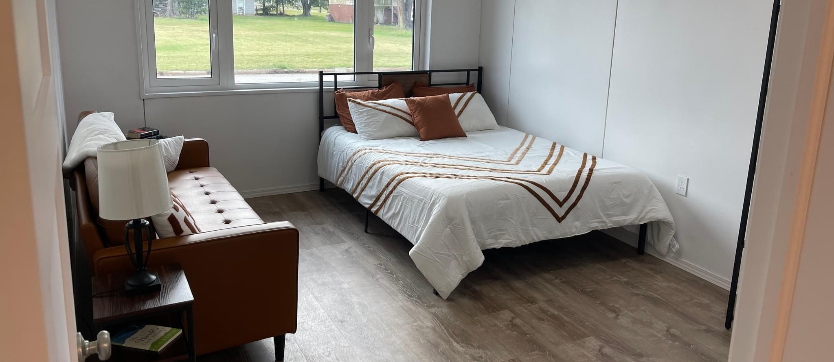

Slide 9
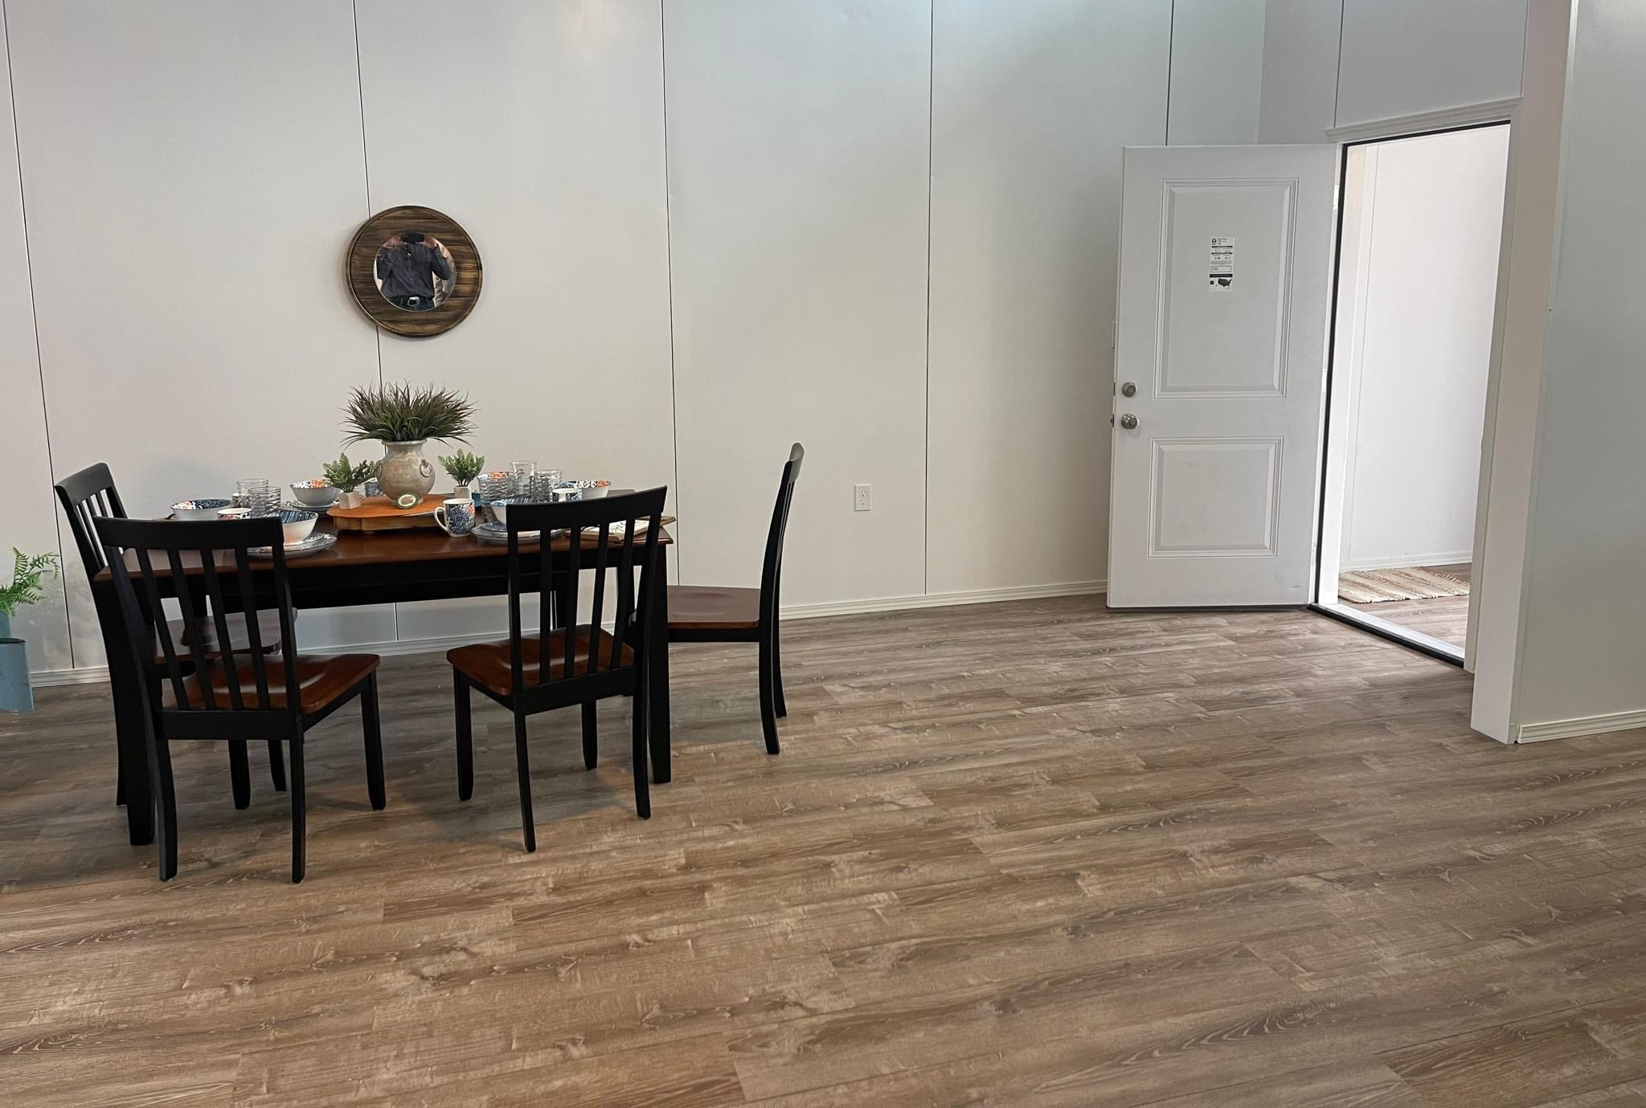
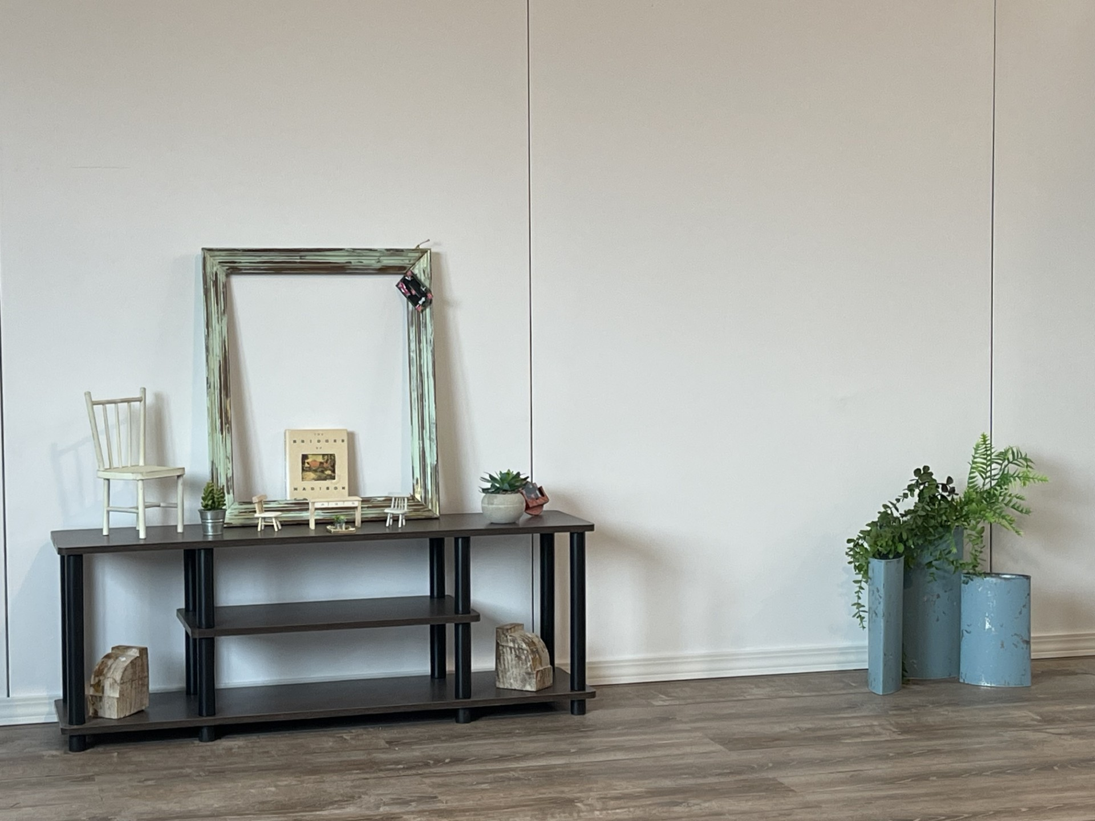
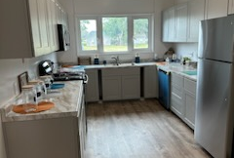

Slide 10
Next Steps
Continue to work with state departments and elected officials to move the housing in the next level for Oklahoma.
Build a one bed/one bath single-senior living house.
Build a three bed/two bath family house.
Continue working the citizens and making strides to affordable housing.

Slide 11
Find the Right Pieces &
Build Homes!

